Slide 1
LECTURE ID :18B11CS311STL09 PROGRAMME : B.Tech. COURSE TITLE : Computer Networks and Internet of Things LECTURE TITLE : Introduction to Internet of Things (IoT) FACULTY NAME : Dr. Shobhit Tyagi

Slide 2
Introduction to Internet of Things (IoT)
By Dr. Shobhit Tyagi Dept. of CSE & IT JIIT, NOIDA

Slide 3
Topics of Today’s Lecture
Introduction to Internet of Things
Internet of Things Reference Model
Internet of Things Reference Architecture

Slide 4
Learning Objectives
On completion of the lecture, you will be able to:

Slide 5
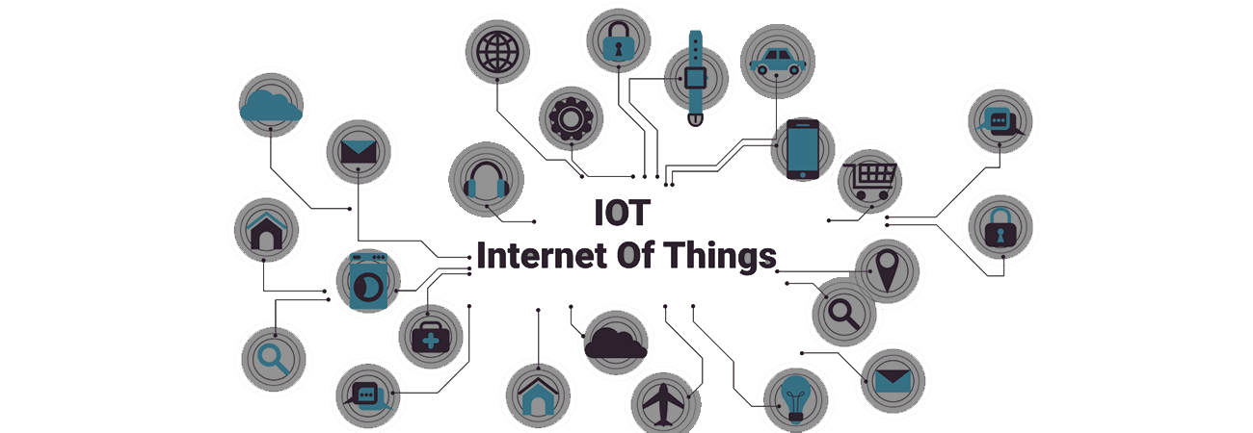
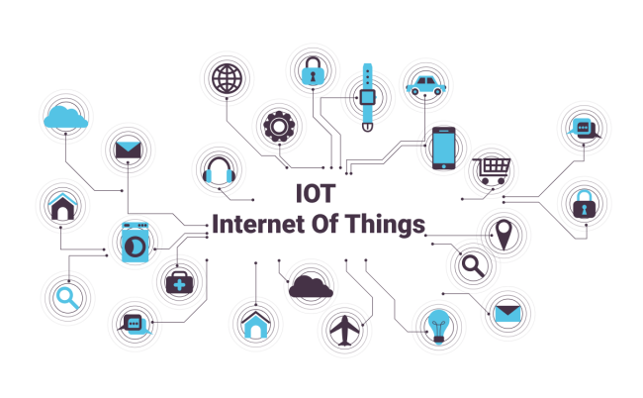
IoT
IoT
Internet of Things

Slide 6
Introduction to IoT
IoT is the network of physical objects or things embedded with electronics, software, sensors and connectivity to enable it to achieve greater value and service by exchanging data with the manufacturer, operator and/or other connected devices.

Slide 7
IoT Components
“Things” or objects are designed in such a way that they can engage in communication without human intervention.
IoT consists of the following components:
Physical Object (Controller, Sensor and Actuators)
Connectivity (Internet)

Slide 8
IoT Components
Controller
Controller is a hardware device or a software program that manages or directs the flow of data between two entities. In computing, controllers may be cards, microchips, or separate hardware devices for the control of a peripheral device.
Sensor
The sensors basically sense the physical phenomena occurred near by to the sensor. Moreover, sensors or devices help in collecting very minute data from the surrounding environment.

Slide 9
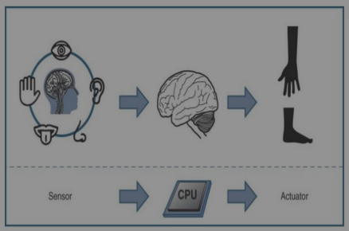
IoT Components
Actuators
The actuators basically based on the sensed information. Actuators, performs operation in physical environment. Moreover, we can say that actuator performs operation, which is based on the sensed information.

Slide 10
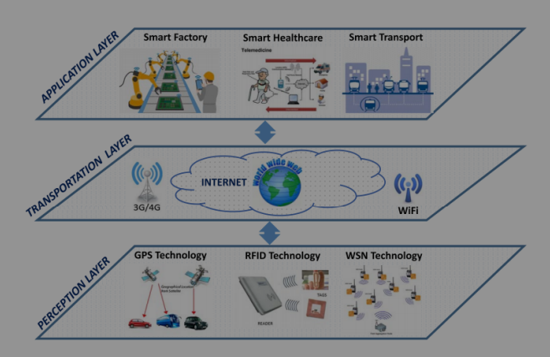
IoT : Layered Architecture

Slide 11
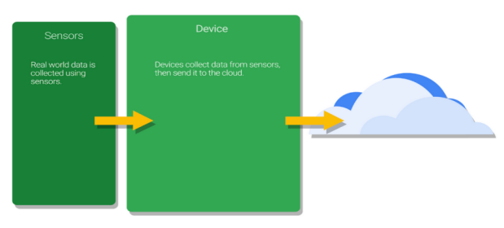
IoT : Working
Sensors
Real world data is collected using sensors
Device
Devices collect data from sensors, then send it to the cloud.
Sensor closely monitor the environmental changes and forward the information to its base station device, which is further transferred to the cloud or processing center.

Slide 12
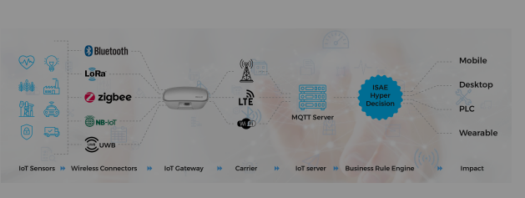
IoT : Working Together

Slide 13
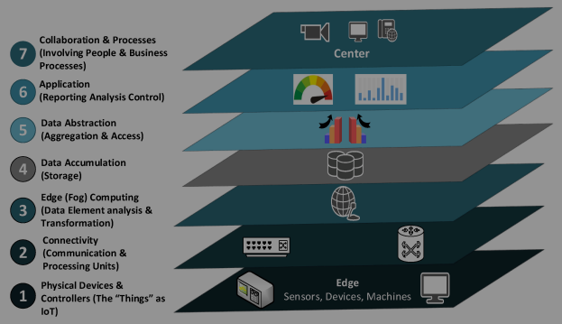
IoT Reference Model
IoT world Forum proposed a reference model to provide the introductory walk through to develop the IoT applications.

Slide 14
IoT Reference Model
IoT Reference Model Physical Devices and Controllers:
This layer represent the “things” in the Internet of Things. Although, this layer is a little ambiguous. On the one hand, the “things” are the assets being managed. From a system design perspective, the “things” are the sensors and devices that are directly managed by the IoT architecture.

Slide 15
IoT Reference Model
Connectivity:
This layer spans from the “middle” of an Edge Node device up through transport to the cloud. Many alternatives can be used for communications and this layer includes the mapping of field data to the logical and physical technologies used as well as the backhaul to the on premise or cloud and the next layer, Edge Computing.

Slide 16
IoT Reference Model
Edge Computing:
The next layer in the World Forum Model architecture is Edge Computing, or more properly ‘Cloud Edge’ or ‘Cloud Gateway’ computing.
Protocol conversion, routing to higher layer software functions and even fast path logic for low latency decision making will be implemented at this layer.

Slide 17
IoT Reference Model
Data Accumulation:
Given the Velocity, Volume and Variety that IoT systems can provide it is essential to provide incoming data storage for subsequent processing, normalization, integration, and preparation for upstream applications.
This layer may be implemented in simple SQL or may require more sophisticated Hadoop & Hadoop File System, Mongo, Cassandra, Spark or other NoSQL solutions.

Slide 18
IoT Reference Model
Data Abstraction:
Data abstraction layer we ‘make sense’ of the data, collecting ‘like’ information from multiple IoT sensors or measurements, expedite high priority traffic or alarms, and organize incoming data from the data lake into appropriate schema and flows for upstream processing.

Slide 19
IoT Reference Model
Application Layer:
This layer is self explanatory and is where control plane and data plane application logic is executed. Monitoring, process optimization, alarm management, statistical analysis, control logic, logistics, consumer patterns, are just a few examples of IoT applications.

Slide 20
IoT Reference Model
Collaboration and Processes :
At this layer, application processing is presented to users, and data processed at lower layers is integrated in to business applications.
This layer is about human interaction with all of the layers of the IoT system and where economic value is delivered.

Slide 21

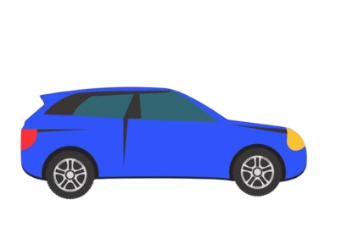



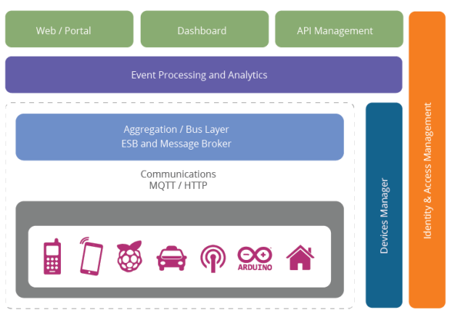
IoT Reference Architecture
Web / Portal
Dashboard
API Management
Event Processing and Analytics
Aggregation / Bus Layer
ESB and Message Broker
Identity & Access Management
Communications MQTT / HTTP
Device Manager

Slide 22
IoT Reference Architecture
The reference architecture consists of a set of components. Layers can be realized by means of specific technologies, and we will discuss options for realizing each component. There are also some cross-cutting/vertical layers such as access/identity management.

Slide 23
IoT Reference Architecture
The layers are :
Client/external communications: Web/Portal, Dashboard, APIs
Event processing and analytics (including data storage)
Aggregation/bus layer ESB and message broker
Relevant transports: MQTT/HTTP/XMPP/CoAP/AMQP, etc.
Devices
The cross-cutting layers are:
Device manager
Identity and access management

Slide 24
IoT Reference Architecture: The Device Layer
The bottom layer of the architecture is the device layer.
Devices can be of various types, but in order to be considered as IoT devices, they must have some communications that either indirectly or directly attaches to the Internet.
Examples of direct connections :
Arduino with Arduino Ethernet connection, Raspberry Pi connected via Ethernet or Wi-Fi.
Each device typically needs an identity.

Slide 25
IoT Reference Architecture: The Device Layer
A unique identifier (UUID) burnt into the device (typically part of the System-on-Chip, or provided by a secondary chip)
The specification is based on HTTP.
However, (as we will discuss in the communications section) the reference architecture also supports these flows over MQTT.

Slide 26
IoT Reference Architecture: The Aggregation/Bus Layer
An important layer of the architecture is the layer that aggregates and brokers communications. This is an important layer for three reasons:
The ability to support an HTTP server and/or an MQTT broker to talk to the devices;
The ability to aggregate and combine communications from different devices and to route communications to a specific device (possibly via a gateway)
The ability to bridge and transform between different protocols, e.g. to offer HTTP-based APIs that are mediated into an MQTT message going to the device.
The aggregation/bus layer provides these capabilities as well as adapting into legacy protocols. The bus layer may also provide some simple correlation and mapping from different correlation models (e.g. mapping a device ID into an owners ID or vice-versa).

Slide 27
The Event Processing and Analytics Layer
This layer takes the events from the bus and provides the ability to process and act upon these events. A core capability here is the requirement to store the data into a database.
This may happen in three forms:
Traditional model or server side processing model such as JAS-RS application backed with database
Big data analytic platform and cloud-scalable platform like Apache Hadoop
Near real-time complex event processing

Slide 28
Device Management
Device management (DM) is handled by two components:
Server side device management
It communicates with devices via various protocols and provides both individual and bulk control of devices.
Remotely Software based device management
It also remotely manages software and applications deployed on the device. It can lock and/or wipe the device if necessary. The device manager works in conjunction with the device management agents.

Slide 29
Device Management
There are multiple different agents for different platforms and device types.
The device manager also needs to maintain the list of device identities and map these into owners.
It must also work with the identity and access management layer to manage access controls over devices (e.g. who else can manage the device apart from the owner, how much control does the owner have vs. the administrator, etc.)

Slide 30
Identity and Access Management
The final layer is the identity and access management layer. This layer needs to provide the following services:
OAuth2 token issuing and validation
Other identity services including SAML2 SSO and OpenID Connect support for identifying inbound requests from the Web layer
XACML PDP
Directory of users (e.g. LDAP)
Policy management for access control (policy control point)
The identity layer may of course have other requirements specific to the other identity and access management for a given instantiation of the reference architecture.

Slide 31
Summary
Introduction to Internet of Things
Internet of Things Reference Model
Internet of Things Reference Architecture

Slide 32
Thank You

